Slide 1
Inventory management
Using Microsoft Power BI

Slide 2
introduction
Inventory Management is the process of overseeing a company's stock, encompassing the acquisition, storage, tracking, and distribution of goods, whether raw materials, work-in-progress, or finished products.
Inventory Management dashboard is useful for Warehouse/ In-plant Inventory Managers to effectively control the Inventory levels and also maintain the Service Levels.

Slide 3
Key components of inventory dashboard
ABC Classification
XYZ Classification
Inventory Turnover Ratio
Safety Stock Levels
Estimation of Reorder Levels and Safety stock
Calculation of Average weekly demands
Stock Status
Forecasting for the next time period

Slide 4
Methodology
In Power BI – Upload Excel file – Get data
Perform ETL
Perform Dax Operations
Create visualizations

Slide 5
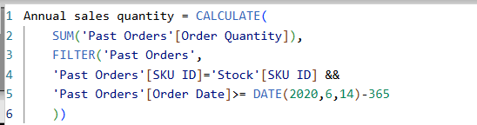
DaX operations
In Stocks Table , add new column:
Annual Sale Quantity: This represents annual sales for last 1 year.
Annual Revenue: This represents annual revenue.

Slide 6
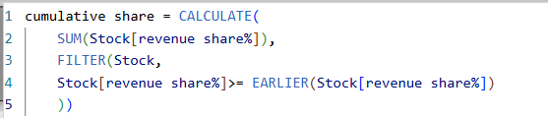
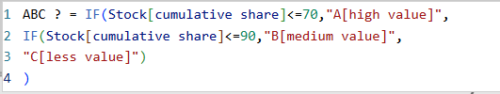
Revenue Share% : This represents the percentage share of each SKU Ids with respect to Total Revenue.
We replaced the blank cells with 0 which means there is No Order received since last 1 year for that particular SKU id.
Cumulative Shares:
ABC ? : Create this column for ABC analysis.
ABC Rank: for generating Pareto chart.

Slide 7
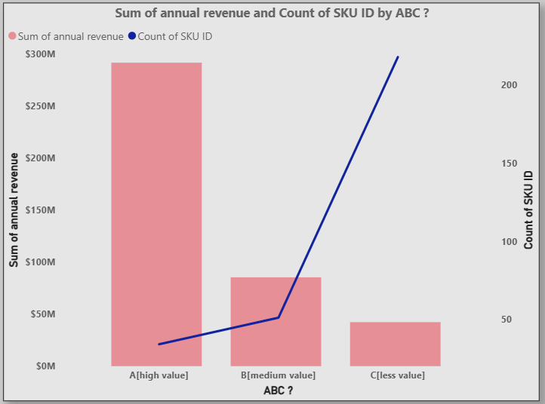
ABC Analysis
ABC Analysis follows the principle called Pareto’s Principle.
It show that the less revenue is generated by more no. of items and higher revenue is generated by less no. of items.

Slide 8
Create new table
Create new table called WEEK TABLE.
Week Date: Generate all weekly dates for last 1 year.
Create new table called SKU TABLE.

Slide 9
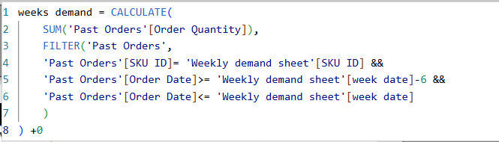
Create new table called WEEKLY DEMAND SHEET.
Add a new column Weeks Demand.
Last 2 conditions indicates to capture all orders from that day, - 6 days & that particular week date.
On observing some blanks, replace them with 0.

Slide 10
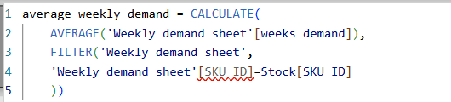
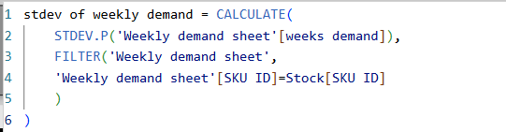
Add new column
In Stocks Table add a new column:
Average weekly demand:
STD DEV of weekly demand: Generates standard deviation of weekly demand for SKU id’s.

Slide 11
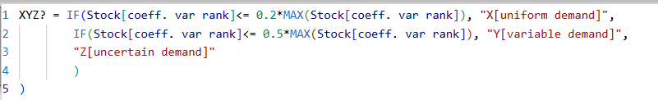
Coefficient of variation: Generated CV for each SKU Id.
CV is classified as: Smaller Value – under X category
In between Value – under Y category
Higher Value – under Z category
CV Rank: It represents the rank of Coefficient of Variation.
XYZ ?: Categorize the items based on their demand and certainty.
This shows the XYZ classification of each SKU Id.
Now we have current stock quantity but we want to represent the value as well for current stock quantity.

Slide 12
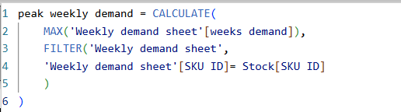
Value in WH: Represents the value in warehouse of current stock quantity.
Create a measure in Stocks Table:
Inventory Turnover Ratio: Represents how efficient is inventory or warehouse management.
Create a new column in Stocks Table:
Peak Weekly Demand: Represents peak weekly demand for each SKU Id for safety stocks.
Safety stocks:

Slide 13
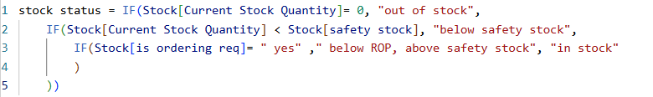
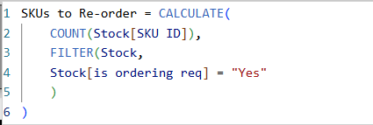
Re-order Point: Depends on safety stocks.
Is ordering required: When the current stock value is less than re-order point.
Stock Status: Categorizes the current stock quantity as in stock or out of stock.
Create a measure in Stocks Table:
SKU to re-order:

Slide 14
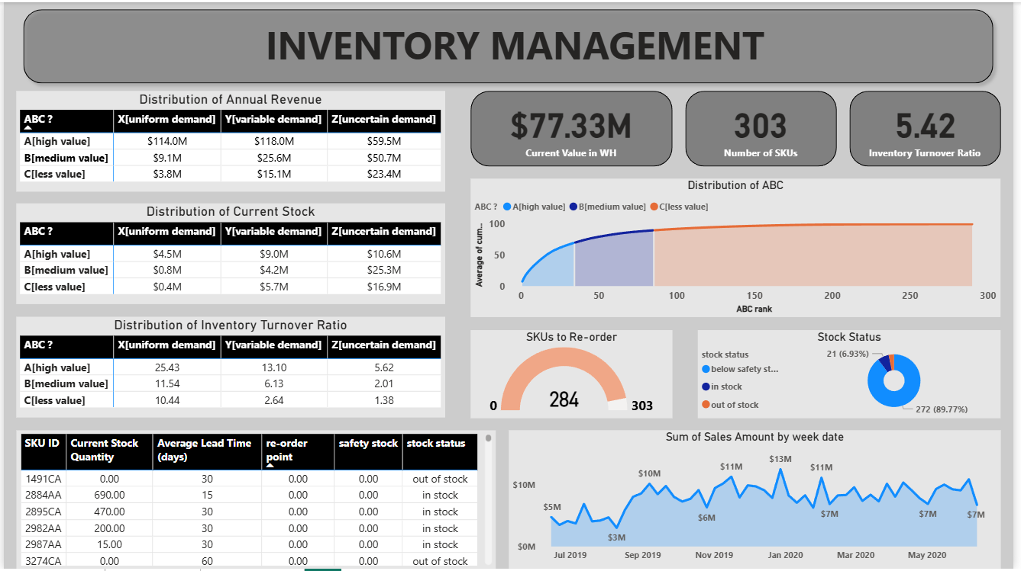
dashboard

